Slide 1
EPA Update for the Adbri CLG
22 July 2024

Slide 2
EPA regulatory actions (May to July 2024)
A number of extensive site inspections of the Adbri facility.
Increased surveillance/environmental observations.
Issuing an Information Discovery Order - a formal request to Adbri for information regarding the dust event.
Meeting with community members face-to-face to better understand community concerns.
Collected dust samples - 19 samples collected and analysed in May/June – further sampling in early July.
Analysis of local air quality data.

Slide 3
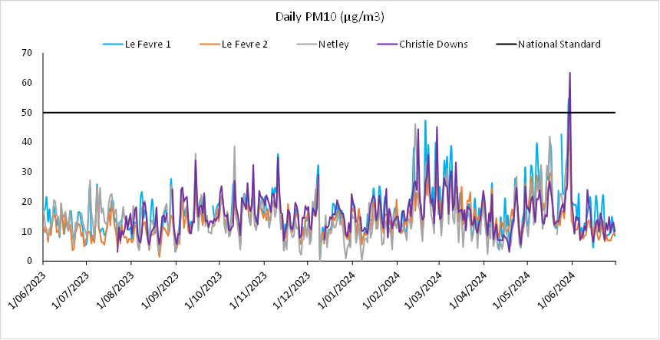
EPA’s Le Fevre air quality monitoring

Slide 4
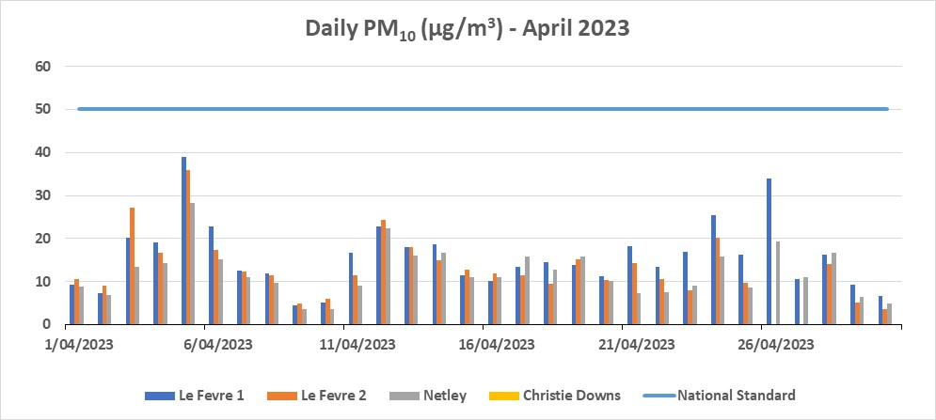
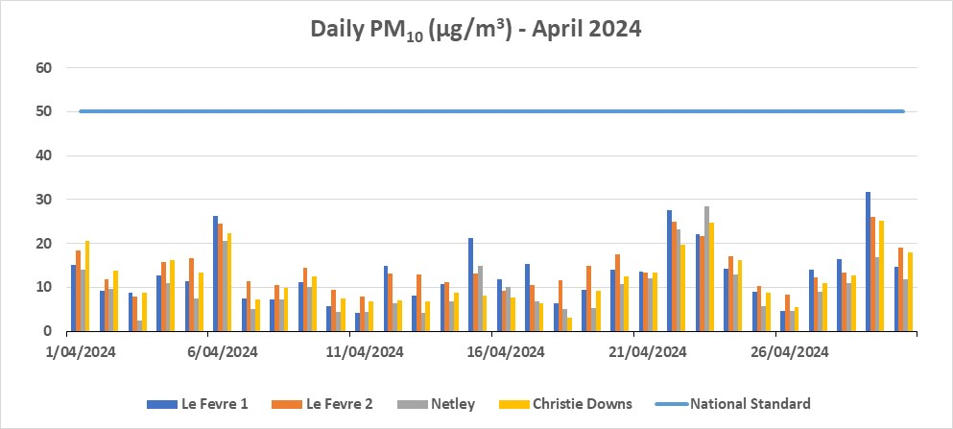
Le Fevre air quality monitoring

Slide 5
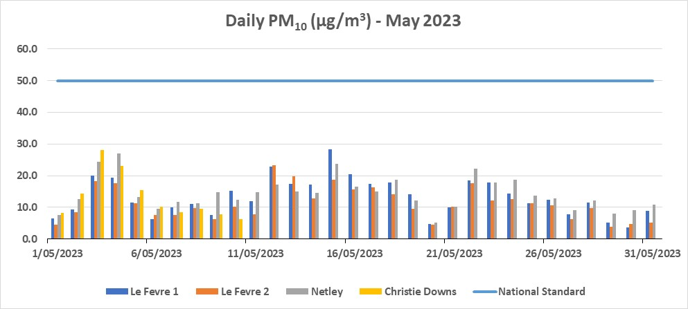
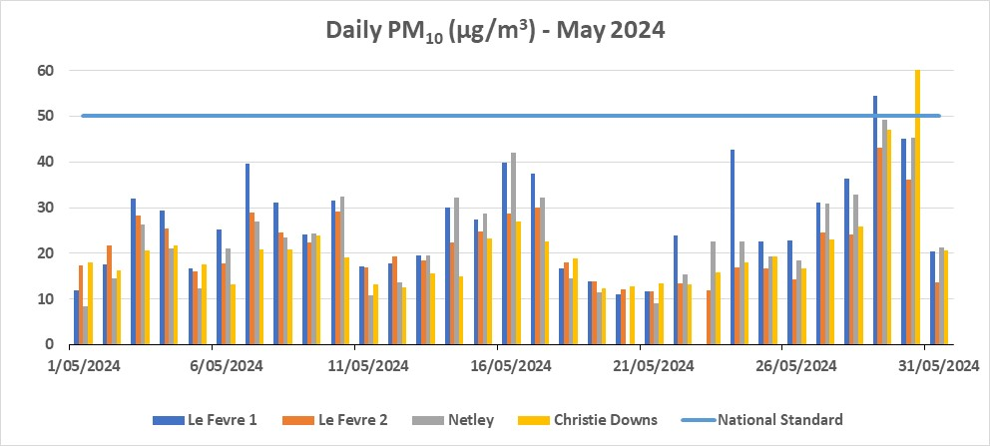
Le Fevre air quality monitoring
Regional dust event
General period of reported dust event

Slide 6
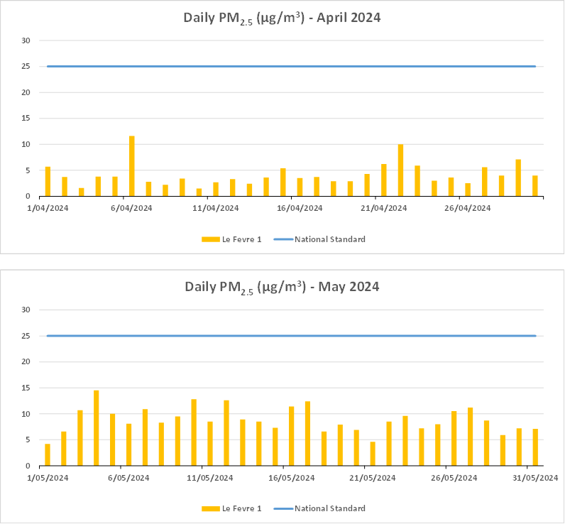

Slide 7
Environmental Sampling
EPA collected 19 deposited dust samples in May 2024 from locations in Birkenhead and surrounding areas.
The samples were sent to a laboratory for analysis and the EPA received the results in June 2024. The results will be published on the EPA website (EPA Engage - https://engage.epa.sa.gov.au/adbri-birkenhead)
For comparative analysis, further environmental samples have been collected by the EPA – from other suburbs and from the Adbri site. The EPA is still waiting on these results, including a chemical analysis of a clinker sample from the Adbri site. The results will be published on the EPA website on.

Slide 8
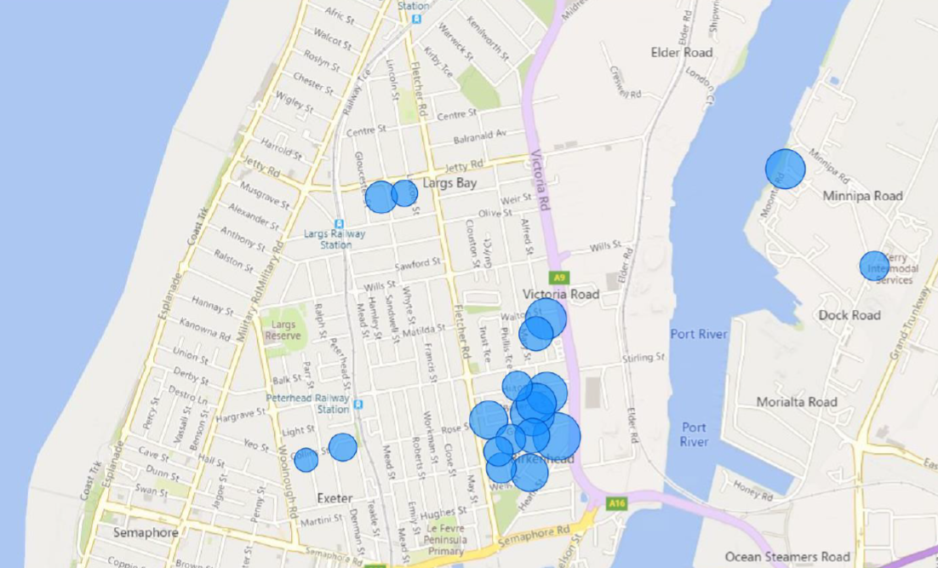
Environmental sampling – calcite results
Calcite (which is essentially limestone – CaCO₃) generally decreased with increasing distance from the Adbri facility.
Limestone is stored in large quantities on the Adbri site.
Calcite is natural mineral found widely in the environment.
The amount of calcite in 19 samples collected ranged between 10% to 52%.
To note, the size of the blue bubble is proportional to the % calcite component

Slide 9
Environmental sampling – hatrurite results
Hatrurite (Ca₃SiO₅), an important mineral phase in cement clinker, was detected in 14 of 19 samples.
Hatrurite generally decreased or was not detected with increasing distance from the Adbri facility. The amount of hatrurite in the samples ranged between 2% to 30%.
To note, the size of the blue bubble is proportional to the % hatrurite component.

Slide 10
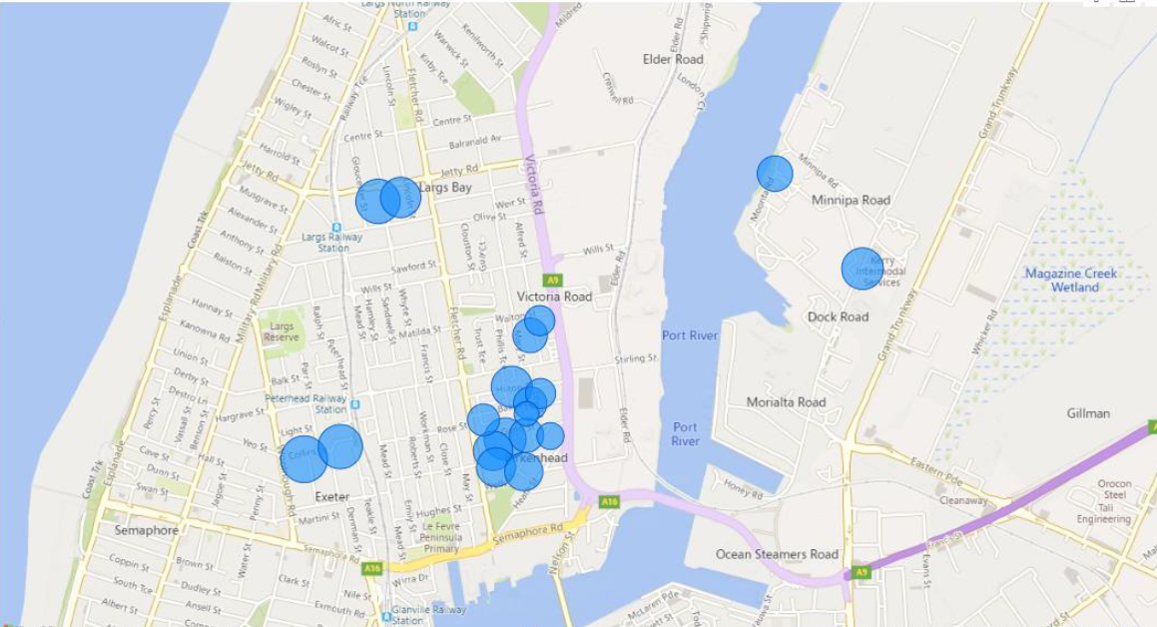
Environmental sampling – quartz results
Quartz (SiO₂, the most common mineral on earth and major component of normal dust) generally increased with increasing distance from the Adbri facility.
The sampling indicated that quartz concentration increased in the samples taken further away from the Adbri facility. The amount of quartz in the samples ranged between 16% to 71%.

Slide 11
Environment Protection Order
The EPA issued Adbri an EPO on 18 July 2024. A copy of the EPO is available on the EPA website at www.epa.sa.gov.au
An Environment Protection Order (EPO) is a legal directive from the EPA that requires a person or company to undertake actions to remedy a risk or prevent environmental harm.
An EPO is issued pursuant to Section 93 of the Environment Protection Act 1993.

Slide 12
Environment Protection Order
The EPO requires Adbri to provide to the EPA, a revised version of the Air Particulate Mitigations Options report to the EPA’s satisfaction. Compliance date 30 September 2024.
The EPO requires Adbri to provide to the EPA a revised version of the Environment Improvement Programme (EIP) to the EPA’s satisfaction. Compliance date 31 October 2024.
The EPO specifies the reasons why these documents were not to EPA satisfaction, and clarifies what must be included in revised versions.
A person to whom an EPO is issued must comply with the EPO. Penalties apply if the EPO is not complied with.

